Slide 1

English Tourism —
Final Report
U0657033 李宛錡
U0657048 逄馥寧
2 Days Travel in Chitou and Taizhong

Slide 2


English Tourism —Final Report
SPENDING
Hmmm...I think I have no money to life for next month.
Transportation
How about take a plane?
3
Itinerary planning
Let’s have a nice travel !
2
Directory
1

Slide 3

English Tourism —Final Report
A happy trip.
Part 1
Itinerary planning
Let’s have a nice travel !

Slide 4
Itinerary planning
DAY1 08:00 ~ Departure ~ 09:30 Taichung Cultural and Creative Industrial park 12:15 YOUR KITCHEN(晨間朝食) 15:25 Nei Hu Elementary School 16:30 LEMID HOTEL CHITOU(米堤大飯店) --> Monster Village(妖怪村)

Slide 5
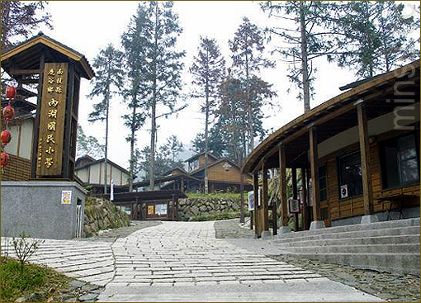

Nei Hu Elementary School

Slide 6
Itinerary planning
DAY1 08:00 ~ Departure ~ 09:30 Taichung Cultural and Creative Industrial park 12:15 YOUR KITCHEN(晨間朝食) 15:25 Nei Hu Elementary School 16:30 LEMID HOTEL CHITOU(米堤大飯店) --> Monster Village(妖怪村)

Slide 7
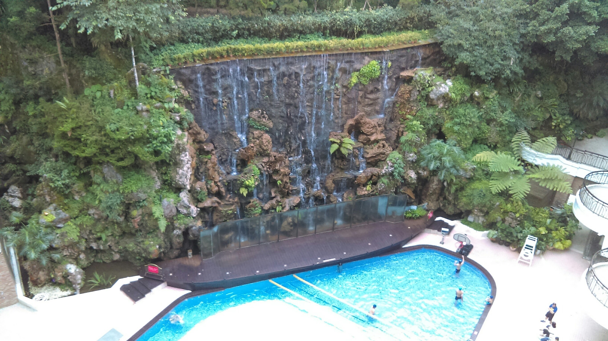
LEMID HOTEL CHITOU

Slide 8
Itinerary planning
DAY1 08:00 ~ Departure ~ 09:30 Taichung Cultural and Creative Industrial park 12:15 YOUR KITCHEN(晨間朝食) 15:25 Nei Hu Elementary School 16:30 LEMID HOTEL CHITOU(米堤大飯店) --> Monster Village(妖怪村)

Slide 9
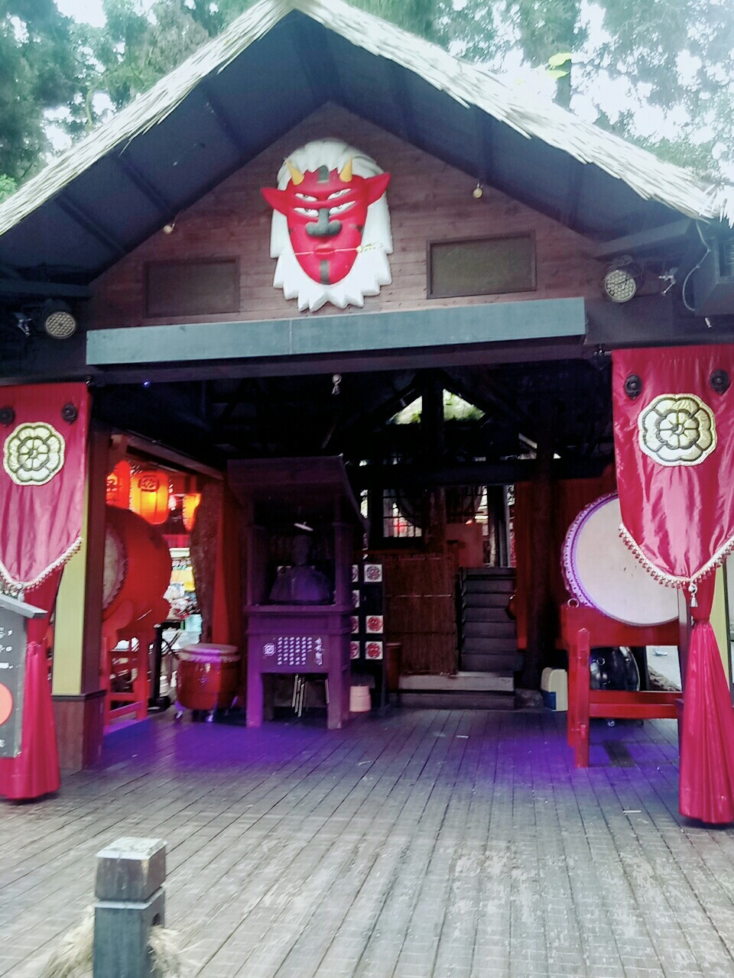
Monster Village

Slide 10
Itinerary planning
DAY2 11:00 Leaving LEMID HOTEL CHITOU(米堤大飯店) 11:40 beef noodle(八張牛肉麵) 12:40 Jiji train station 15:45 Nantou Sky Ladder(猴探井天空之橋) 16:35 Sunnyhills ＆ Nantou San Ho Yuan(微熱山丘 南投三合院) 18:00 Korea Restaurant in Taichung(韓鄉韓國料理 臺中店) 20:00 Maple Garden (秋紅谷公園) 21:00 back to the warm and lovely home ~

Slide 11
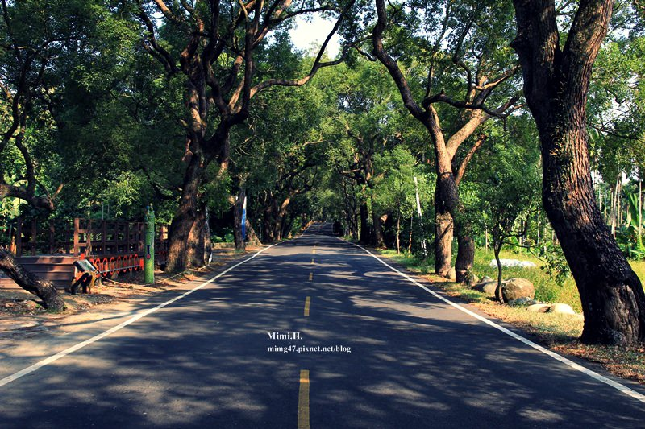
Jiji train station

Slide 12
Itinerary planning
DAY2 11:00 Leaving LEMID HOTEL CHITOU(米堤大飯店) 11:40 beef noodle(八張牛肉麵) 12:40 Jiji train station 15:45 Nantou Sky Ladder(猴探井天空之橋) 16:35 Sunnyhills ＆ Nantou San Ho Yuan(微熱山丘 南投三合院) 18:00 Korea Restaurant in Taichung(韓鄉韓國料理 臺中店) 20:00 Maple Garden (秋紅谷公園) 21:00 back to the warm and lovely home ~

Slide 13
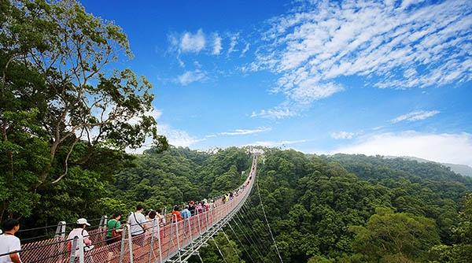
Nantou Sky Ladder

Slide 14
Itinerary planning
DAY2 11:00 Leaving LEMID HOTEL CHITOU(米堤大飯店) 11:40 beef noodle(八張牛肉麵) 12:40 Jiji train station 15:45 Nantou Sky Ladder(猴探井天空之橋) 16:35 Sunnyhills ＆ Nantou San Ho Yuan(微熱山丘 南投三合院) 18:00 Korea Restaurant in Taichung(韓鄉韓國料理 臺中店) 20:00 Maple Garden (秋紅谷公園) 21:00 back to the warm and lovely home ~

Slide 15
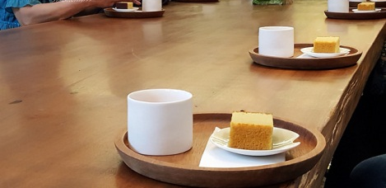
Sunnyhills

Slide 16
Itinerary planning
DAY2 11:00 Leaving LEMID HOTEL CHITOU(米堤大飯店) 11:40 beef noodle(八張牛肉麵) 12:40 Jiji train station 15:45 Nantou Sky Ladder(猴探井天空之橋) 16:35 Sunnyhills ＆ Nantou San Ho Yuan(微熱山丘 南投三合院) 18:00 Korea Restaurant in Taichung(韓鄉韓國料理 臺中店) 20:00 Maple Garden (秋紅谷公園) 21:00 back to the warm and lovely home ~

Slide 17
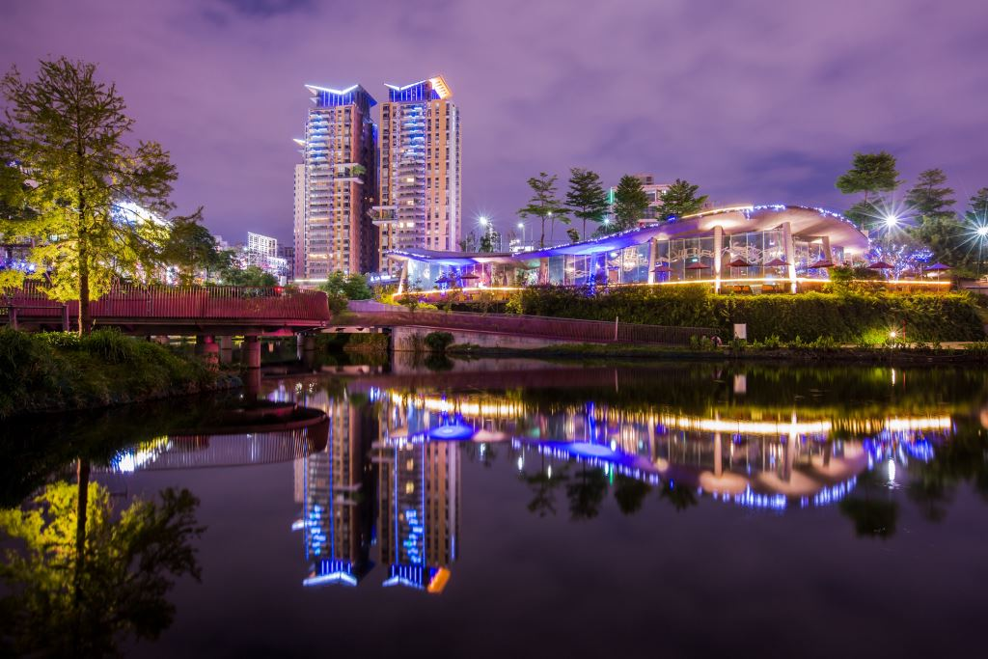
Maple Garden

Slide 18
English Tourism —Final Report
Part 2
Transportation
How about take a plane?

Slide 19
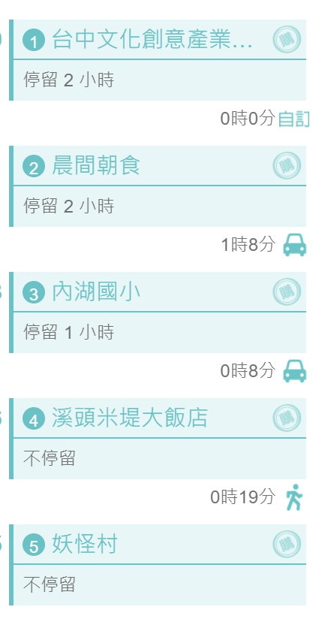
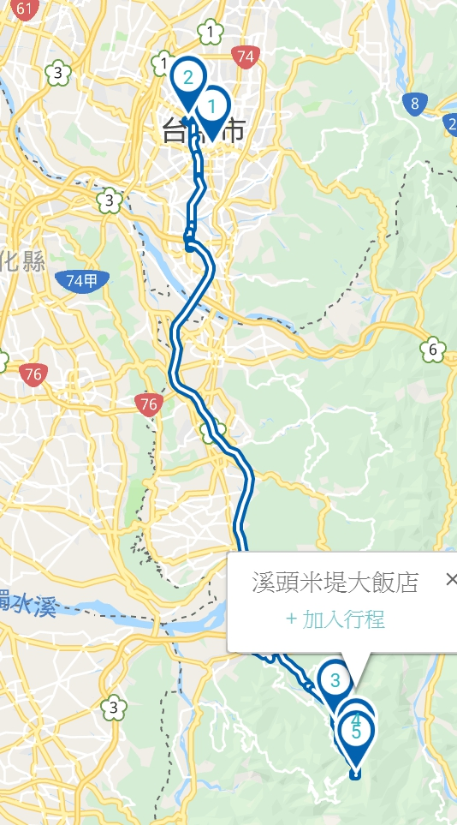

Traffic routes
Departure from Taoyuan.
DAY 1
(197 KM)

Slide 20
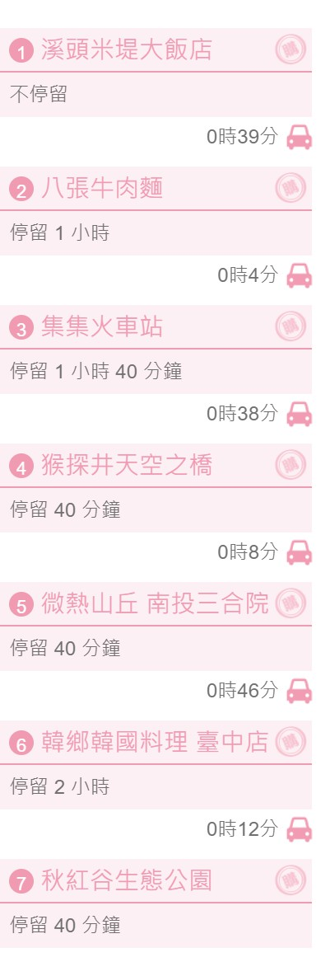
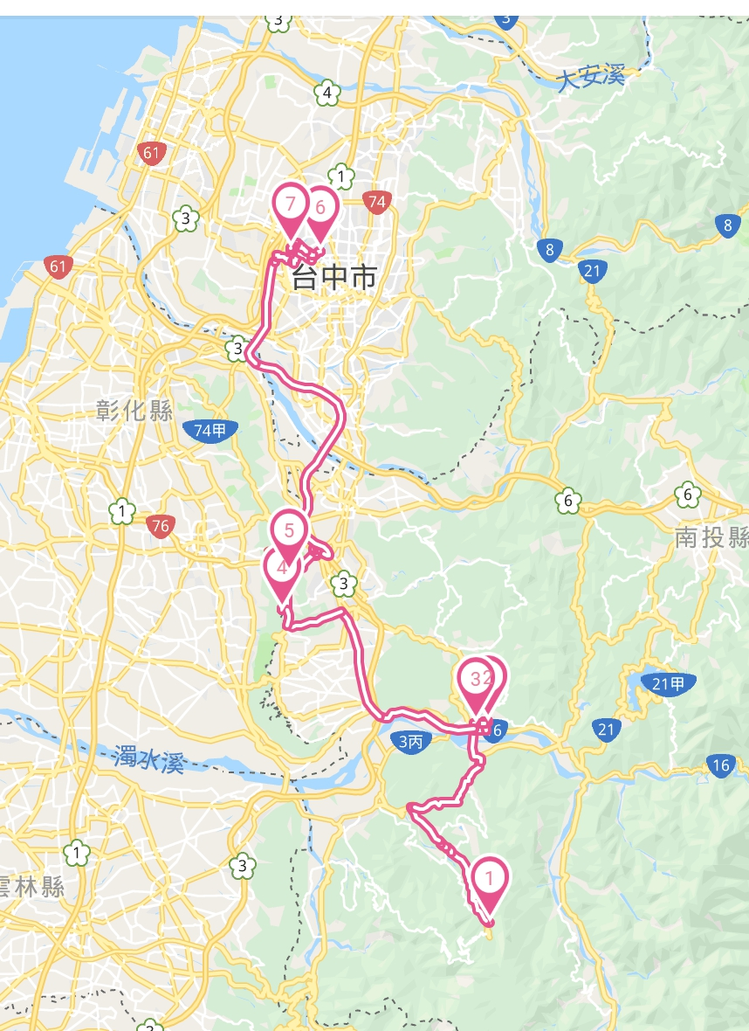
Traffic routes
Departure from LEMID HOTEL CHITOU and start to go home.
DAY 2
(197 KM)

Slide 21
English Tourism —Final Report
Part 3
SPENDING
Hmmm...I think I have no money to life for next month.

Slide 22
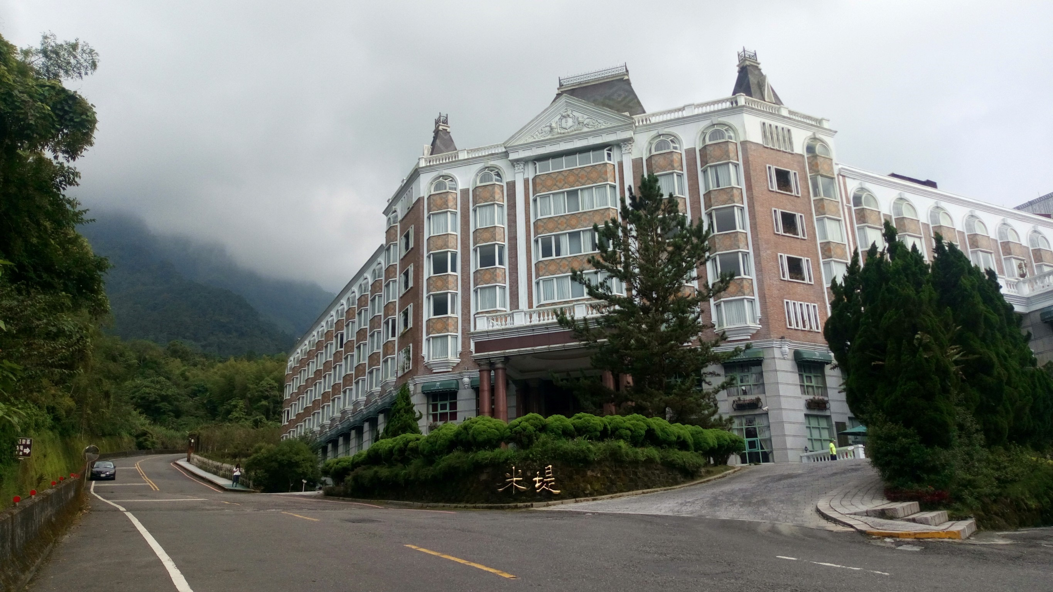


How much do we need?
Total Money
Have a nice holiday.
The money we spend on...
FOOD
LIVE
DAY 1
LUNCH→YOUR KITCHEN:NT＄250/person
DINNER → INCLUDE IN LEMID HOTEL CHITOU : NT＄ 0
LEMID HOTEL CHITOU:
NT＄3980/DOUBLE ROOM
DAY 2
BREAKFAST → INCLUDE IN LEMID HOTEL CHITOU : NT＄ 0
LUNCH → beef noodle: NT＄80/person
DINNER→ Korea Restaurant in Taichung :250/person
OTHER : NT ＄300

Slide 23


How much do we need?
Total Money
Have a nice holiday.
The money we spend on...
ENTERTAINMENT
TRAFFIC
TICKET : NT＄250/PERSON
Souvenirs : NT＄300/PERSON
PARKING : 50 /CAR
OIL : 500/CAR
TOTAL:NT＄5685

Slide 24
English Tourism —Final Report
Thank You!

